Slide 1
Pedagogic Value in Understanding Computer Architecture of Implementing the Marie Computer from Null and Lobur in the Logic Emulation Software, Multimedia Logic
Timothy Stanley*, Daniel Prigmore*, Scott Mikolyski, George Embrey, Leslie Fife, Don Colton
Brigham Young University – Hawaii
* Presenters

Slide 2
Outline
Background (Assignment Approach)
Choice of Marie by Null and Lobur
  Simulated Computer with Data Path Animator
  Assembler and Editor
  Used for Computer Organization Classes
Marie Emulated in Multi-Media Logic
  Requires building the data path
  Requires designing the control circuitry
  Runs programs assembled with Null’s Marie

Slide 3
Assignment Approach
Ask for a one page design specification
Show an example specification
Work through development to specification
Have weekly status reports
Present designs to Dean, Department Chairs, and interested students

Slide 4
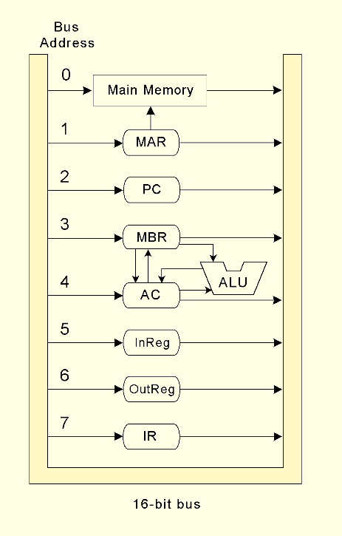
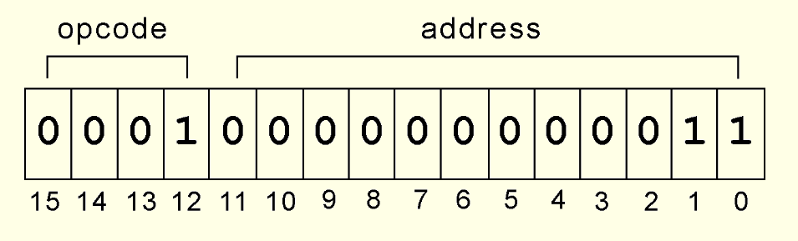
MARIE* by Null & Lobur
* Machine Architecture that is Really Intuitive and Easy

Slide 5
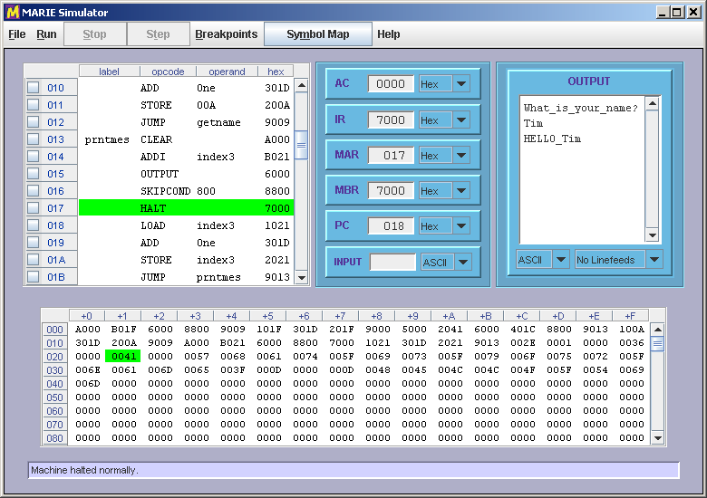
Marie User Interface

Slide 6
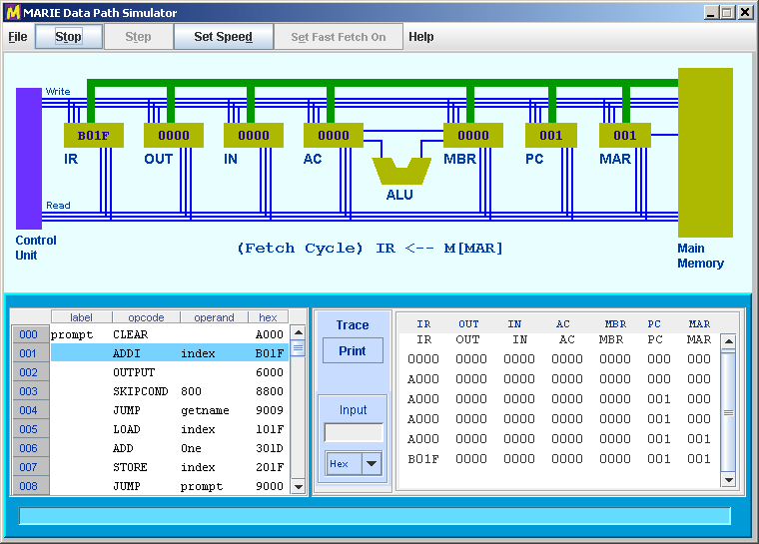
Marie Data Path Simulator

Slide 7
Marie in Multimedia Logic*
Machine codes from Assembly Listing
  Need to separate into higher and lower byte
  Copy into separate 8 bit RAM chips in MML
Full implementation except skip conditional if Acc < 0
  Did not know how to test for Acc < 0
  Worried about unsigned numbers
* Mulimedia Logic (MML) software by George Mills, available at Softronix.com

Slide 8
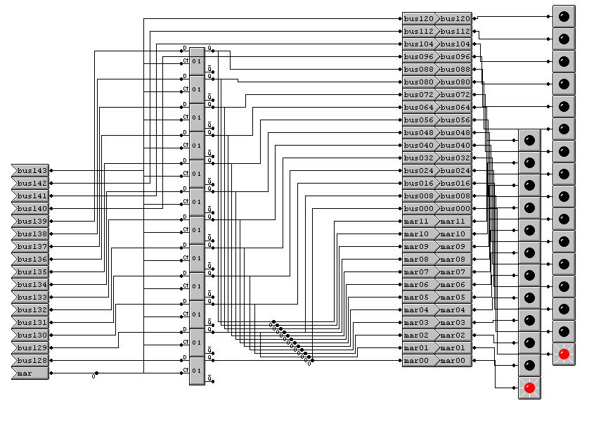
Memory Address Register (MAR)

Slide 9
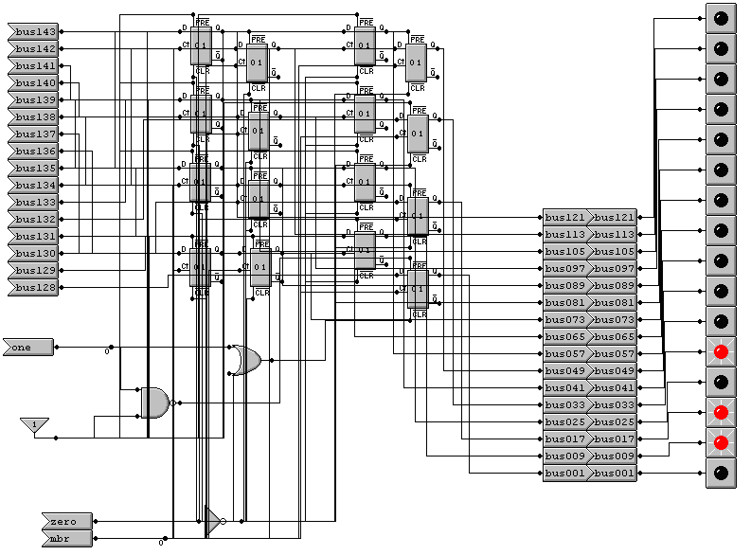
Memory Buffer Register (MBR)

Slide 10
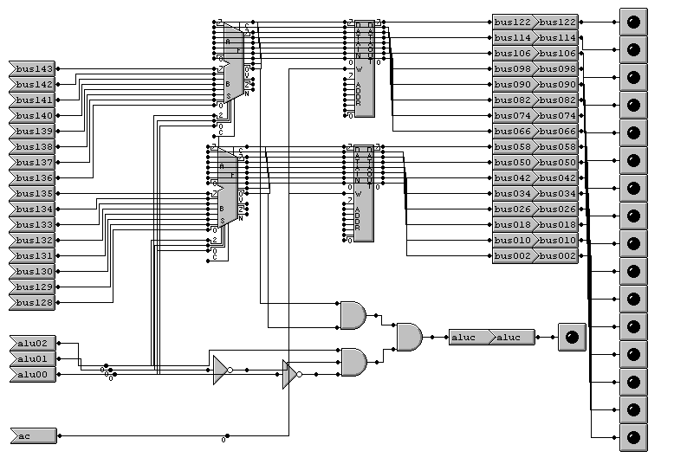
Accumulator and ALU

Slide 11
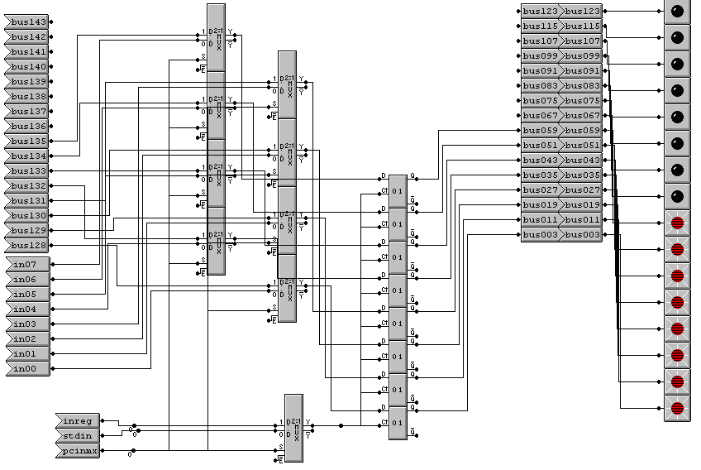
Input Register

Slide 12
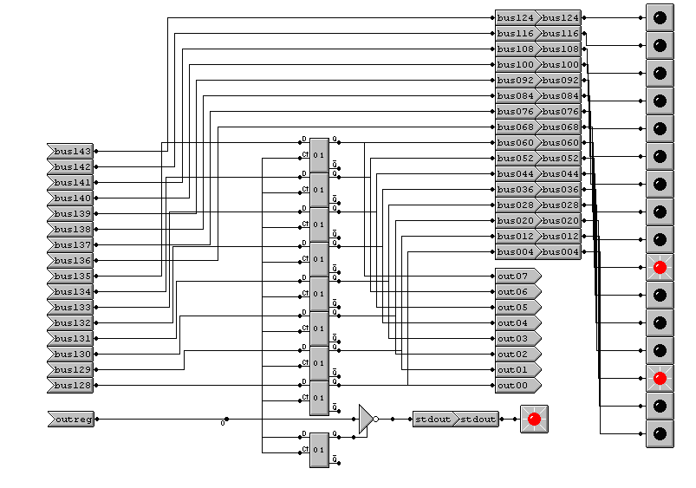
Output Register

Slide 13
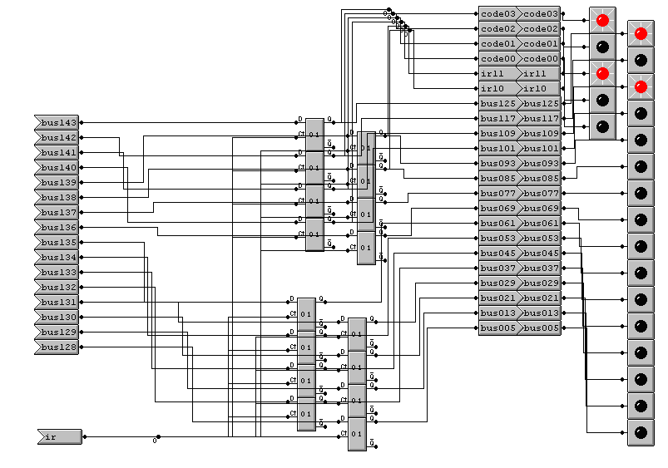
Instruction Register (IR)

Slide 14
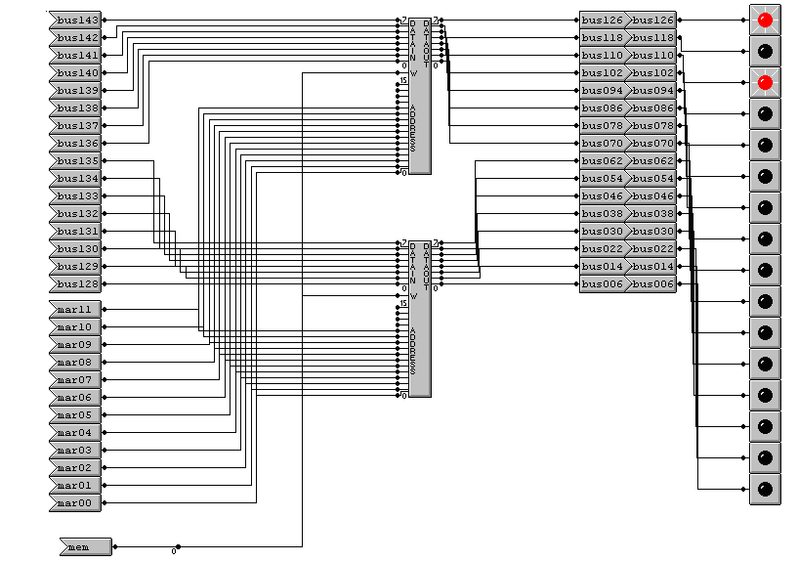
Memory

Slide 15
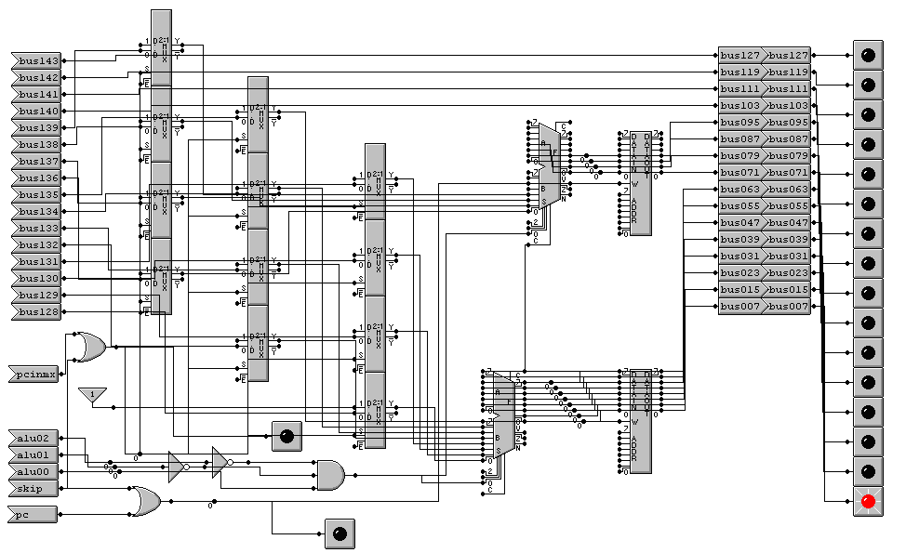
Program Counter & Incrementer

Slide 16
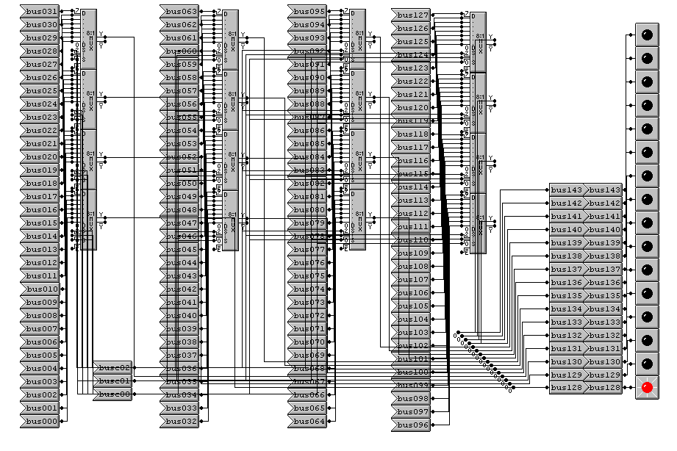
Bus

Slide 17
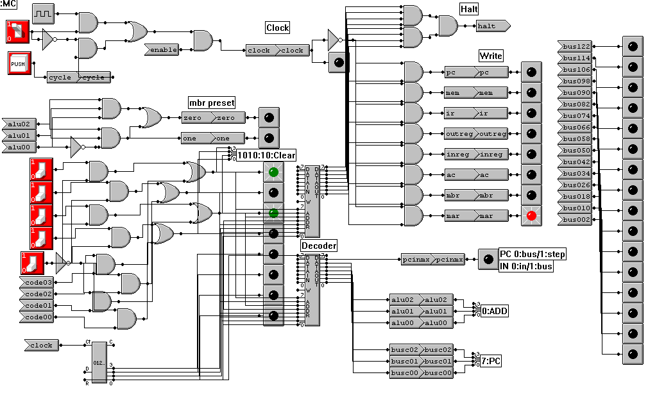
Control Logic & Decoder ROM

Slide 18
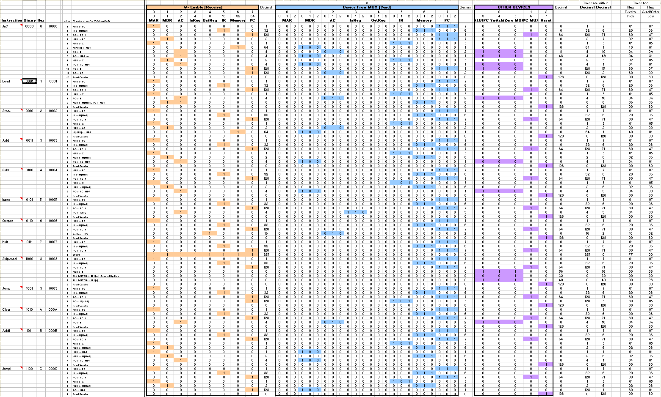
Instruction Decoder ROM

Slide 19
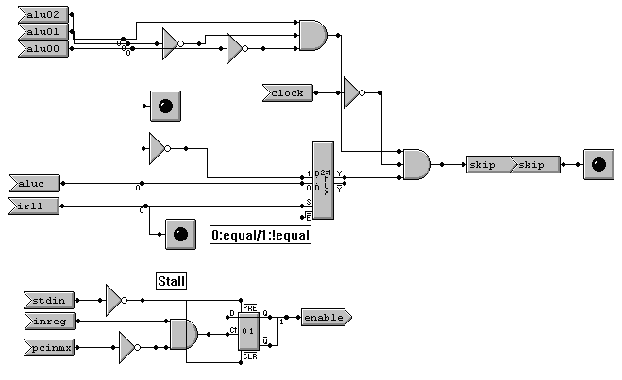
Conditional Execution Logic

Slide 20
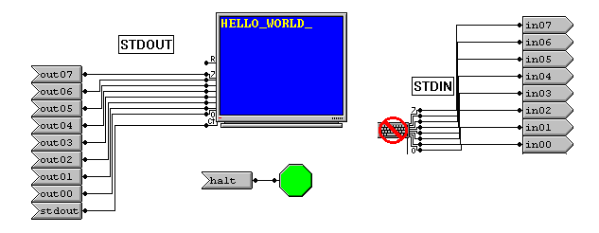
Input / Output Interface

Slide 21
Results & Conclusions
Understanding through design & building
  Data Paths
  Address Bus
  Control Logic and Bus
  Programming with a limited instruction set
  Machine language programming
A deep appreciation for computers, operating systems and compliers

