Slide 1
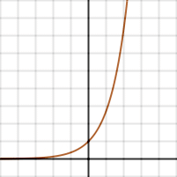
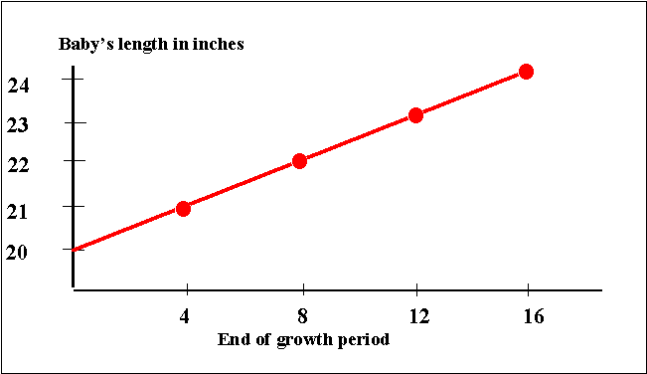
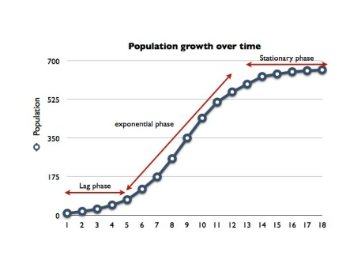
Concept Splash
Mutations
Genetic Variation
Beneficial Mutation
Logistic
Growth
Population Change
Exponential Growth
Linear Growth

